Slide 1
Docker Volumes
Sameer Zulfi

Slide 2
Volumes & Persistent Data
Two categories of Data. Persistent & Non-Persistent
Persistent is the stuff you need to keep.
Things like customer records, financials, bookings, audit logs or other type of application logs.
Non-Persistent is the stuff you don’t need to keep.
Both data are important.
Every Docker container gets its ow non-persistent storage.
It’s automatically created alongside the container. Means deleting the container will delete the storage
If you want your container data to persist, then you should use VOLUME.

Slide 3
Volumes
Volumes are de-coupled from Containers.
It means you can delete the container, but the data in the volume will be preserved.
Sometimes people will call containers are great at stateless and non-persistent stuff.
By Default, every container automatically gets a bunch of local storage. This is where all o the container’s file and filesystem go.
You will hear couple of names like local storage, graphdriver storage or snapshotter storage.
On linux it exists somewhere under /var/lib/docker/<storage driver> as part of container

Slide 4
Choose the right storage driver
RHEL : User overlay2 with modern versions of RHEL running Docker 17.06 or higher. Use the devicemapper driver with older version.
Ubuntu : Use overlay2 or aufs drivers. If you are using Linux 4.x kernel or higher you should go with overlay2.
SUSE Linux Enterprise Server: Use btrfs storage driver

Slide 5
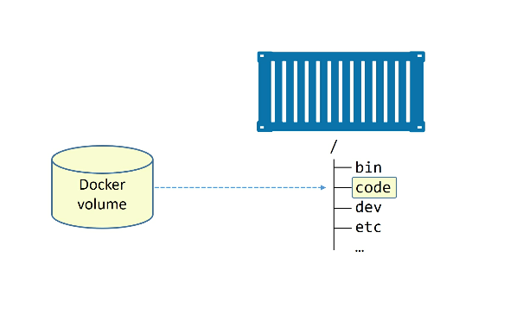
Containers & Persistent Data
Volumes are the safest way to store the data
You create a volume – Create a container – Mount the volume into it.
This shows the
Decoupling between
Volume and Code

Slide 6
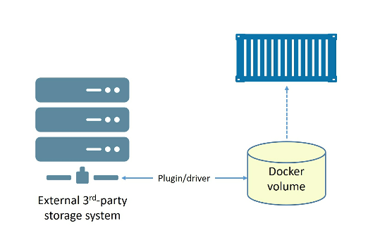
Creating & Managing Docker Volumes
Docker volume create myvol
Types of Storage in functionality:
Block Storage – For high performance EBS, OpenStack Block Storage Service.
File Storage – NFS & SMB Protocols.EFS, Azure Files Storage
Object Storage – Good for Long term storage.S3, Ceph

Slide 7
Let’s inspect the volume which we have created. Please Look for the MountPoint
Docker volume inspect myvol
How to delete the docker Volumes?
There are Two Ways to delete :
Docker volume prune ( this will delete all the volumes that are not mounted to any service / container /replicas )
Docker volume rm ( will explicitly ask you to mention the volum name )
As myvol is not in use, let’s prune it
Docker volume prune
Congratulations, you have created, inspected & deleted a volume

Slide 8
Demonstrating Volumes with Containers and Services
Let’s create a new standalone container and mount a volume called “bizvol”
Docker container run –dit –name voltainer –mount source=bizvol,target=/vol alpine
The command should run successfully, even though there is no volume on the system called bizvol. This raises an interesting point: If you specify an existing volume, Docker will use the existing volume. If you specify a volume that does not exist, Docker will create it for you
Try and see “ docker volume ls “ . In our case bizvol was never there, but it created and mounted it into the new container

Slide 9
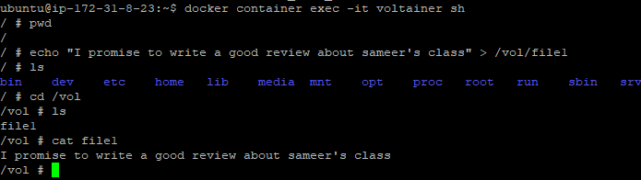
What we have done so far is there is a volume called “bizvol” and one container is using this “bizvol” volume. Means there is a friendship band between these two.
The Container “voltainer” is using the Volume “bizvol”
Let’s try “docker volume rm bizvol” , it will scold you. Isn’t it ?
Good. Now the volume is fresh and empty.
Let’s try adding some data into it.
Let’s enter into the container by running the below command
docker container exec -it voltainer sh
You are inside the container now. Good

Slide 10
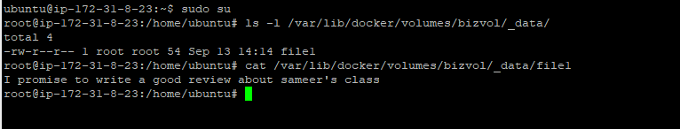
Now type exit out of the container and return to your docker host shell.
Now delete the container with the following command.
Docker container rm voltainer –f
You have removed the container, but the volume still exists.
Docker volume ls
You will see the bizvol
Because the volume still exists, you can look at it’s mountpoint on the host to check whether the file you have created is still there or not.
Execute the screenshot commands. Great – The volume and data still exists

Slide 11
Let’s try to mount the bizvol to a Service
The following command creates a new Docker Service, called hellcat and mounts bizvol into the service replica at /vol.
First, Rung a single Ubuntu instance for our example and initialize the swarm.
Docker swarm init
Then run the command “docker service create --name hellcat --mount source=bizvol,target=/vol alpine sleep 1d “
Which says Service name is hellcat and Mount the bizvol into this service
Docker ps
And enter into that container.
Now verify whether you have the same file which was created earlier is here in this container or not. i.e., under /vol
Excellent – Good job

Slide 12
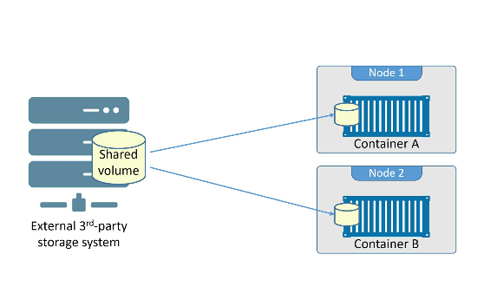
Sharing Storage across cluster nodes

